Slide 1
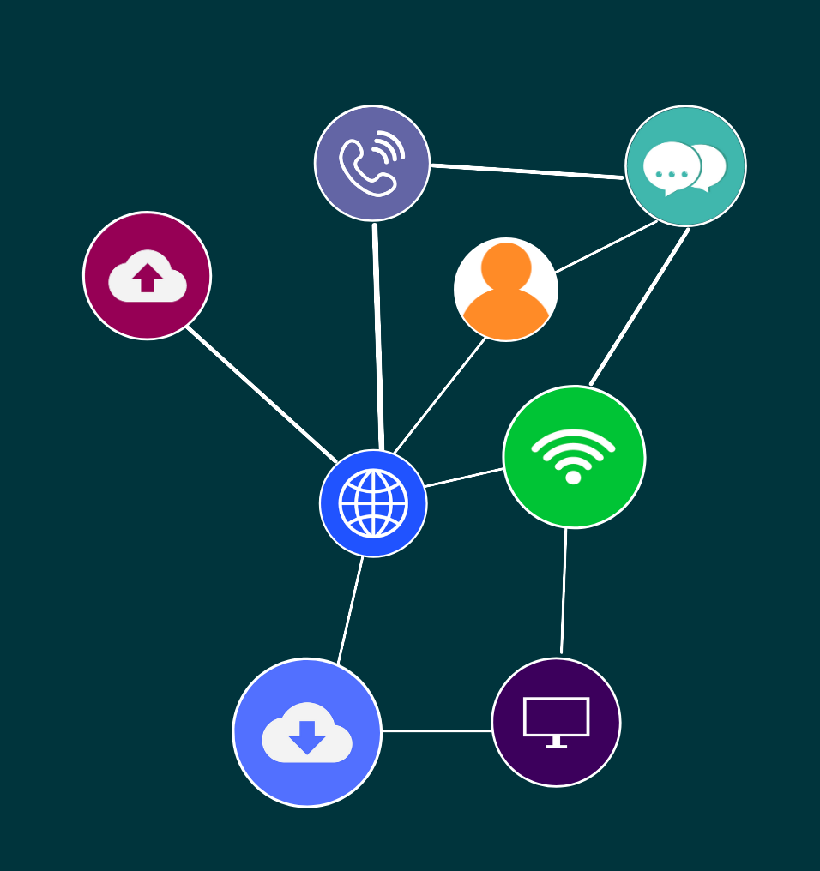

ICTNWK612
Plan and manage troubleshooting advanced integrated IP networks

Slide 2
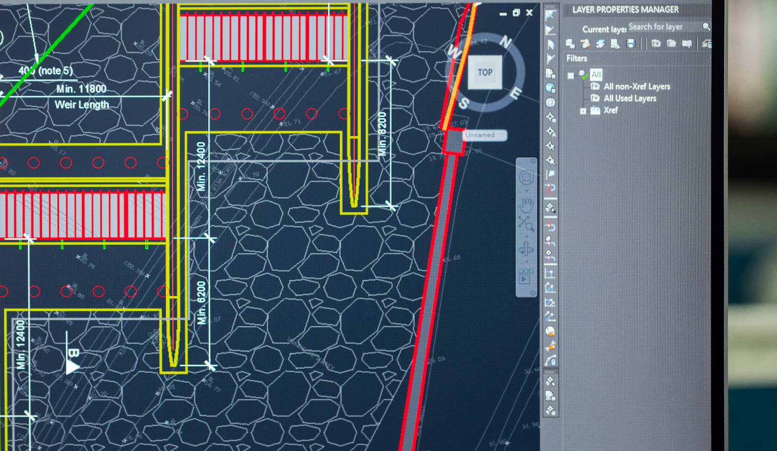
‹#›
Topic 1: Strategies to troubleshoot and monitor advanced integrated IP networks
© 2021 Milestones International College

Slide 3

‹#›
ACTIVITY: BRAINSTORM
Threats and risks that can occur if an integrated network is not continually tested and monitored.
Your trainer/assessor will facilitate a discussion.
Topic 1: Strategies to troubleshoot and monitor advanced integrated IP networks
© 2021 Milestones International College

Slide 4
‹#›
INTRODUCTION
Integrated IP networks can include:
Data
Voice
Video
Topic 1: Strategies to troubleshoot and monitor advanced integrated IP networks
Topic 1: Insert topic title
© 2021 Milestones International College

Slide 5
‹#›
IP NETWORK TOPOLOGIES, ARCHITECTURES, AND ELEMENTS
Understanding networks is important to manage network performance.
There are many types of networks such as LAN, WAN and the Internet.
The type of network used by a business will depend on the type and size of the business, as well as how data is used.
Topic 1: Strategies to troubleshoot and monitor advanced integrated IP networks
Topic 1: Insert topic title
© 2021 Milestones International College

Slide 6
‹#›
ACTIVITY: READ
Read about types of networks and topologies.
Read more on network architecture.
Read the article explaining the TCP/IP model, layers and protocols used in networking.
Topic 1: Strategies to troubleshoot and monitor advanced integrated IP networks
© 2021 Milestones International College

Slide 7
‹#›
ACTIVITY: WATCH
Watch the following video explaining mesh networks.
Video: https://www.youtube.com/watch?v=8UZlwhiWKmA (01:38)
Write down any key takeaways.
Topic 1: Strategies to troubleshoot and monitor advanced integrated IP networks
© 2021 Milestones International College

Slide 8
‹#›
NETWORKING STANDARDS AND PROTOCOLS
Network standards that are related to security for applications include the different layers in the Open System Interconnect (OSI) model it defines a networking framework to implement protocols in seven layers.
Topic 1: Strategies to troubleshoot and monitor advanced integrated IP networks
Topic 1: Insert topic title
© 2021 Milestones International College

Slide 9
‹#›
ACTIVITY: READ
IBM has produced documentation listing common networking standards relating to both LAN, WAN and VPN networks.
Website: https://www.ibm.com/docs/en/i/7.3?topic=communications-common-networking-standards
Website: https://www.ibm.com/docs/en/i/7.3?topic=networking-concepts
Read more about the OSI model.
Website: https://www.imperva.com/learn/application-security/osi-model/
Topic 1: Strategies to troubleshoot and monitor advanced integrated IP networks
© 2021 Milestones International College

Slide 10
‹#›
ADVANCED NETWORK SOLUTIONS
The network solutions chosen for an organisation should be of high performance and scalable.
Topic 1: Strategies to troubleshoot and monitor advanced integrated IP networks
Topic 1: Insert topic title
© 2021 Milestones International College

Slide 11
‹#›
OPERATING SYSTEMS
You may be working with several different operating systems during your working life.
Each operating system will have its own associated hardware and software used in integrated networking systems, as well as tools, configurations, protocols and networking performance tools.
Topic 1: Strategies to troubleshoot and monitor advanced integrated IP networks
Topic 1: Insert topic title
© 2021 Milestones International College

Slide 12
‹#›
ACTIVITY: DEVELOP
For this first activity, provide some background on the network infrastructure that you will be using. Include any available network diagrams, maps and information provided by your trainer/assessor.
Topic 1: Strategies to troubleshoot and monitor advanced integrated IP networks
© 2021 Milestones International College

Slide 13
‹#›
OPTIMISING PERFORMANCE AND RELIABILITY
To optimise the performance and reliability of an IP network, you can develop a plan to monitor and manage the network.
Topic 1: Strategies to troubleshoot and monitor advanced integrated IP networks
Topic 1: Insert topic title
© 2021 Milestones International College

Slide 14
‹#›
ACTIVITY: READ
Read more about the importance of network management here:
https://blog.gigamon.com/2019/03/21/what-is-network-management/
Make notes for future reference.
Topic 1: Strategies to troubleshoot and monitor advanced integrated IP networks
© 2021 Milestones International College

Slide 15
‹#›
OPTIMISING PERFORMANCE AND RELIABILITY
An important part of network management is performance management and fault analysis. This is usually carried out by network monitoring software included as part a network management system.
Topic 1: Strategies to troubleshoot and monitor advanced integrated IP networks
Topic 1: Insert topic title
© 2021 Milestones International College

Slide 16
‹#›
NETWORK SEGMENTS
Network segmentation is the approach used to divide a network into multiple subnets (sub networks, each acting as its own smaller network).
When you segment the network, you can better prevent unauthorised users and protect critical assets.
Topic 1: Strategies to troubleshoot and monitor advanced integrated IP networks
Topic 1: Insert topic title
© 2021 Milestones International College

Slide 17
‹#›
ACTIVITY: READ
Read more on network segmentation:
https://www.varonis.com/blog/network-segmentation/
Implementing network segmentation:
https://hitinfrastructure.com/features/how-network-segregation-and-segmentation-can-stop-ransomware-attacks
Read some best practices to improve security.
Website: https://www.spamtitan.com/web-filtering/network-segmentation-best-practices/
Topic 1: Strategies to troubleshoot and monitor advanced integrated IP networks
© 2021 Milestones International College

Slide 18
‹#›
TESTING SEQUENCES AND SCENARIOS
It is important to plan for testing, including testing sequences and scenarios to address changes in the network, security issues, emergencies impacting business operations, a planned expansion, or possible situations that could occur.
Topic 1: Strategies to troubleshoot and monitor advanced integrated IP networks
Topic 1: Insert topic title
© 2021 Milestones International College

Slide 19
‹#›
NETWORKING TESTING AND MONITORING TOOLS
“Network performance monitoring is the process of visualising, monitoring, optimising, troubleshooting and reporting on the health and availability of your network as experienced by your users.”
Topic 1: Strategies to troubleshoot and monitor advanced integrated IP networks
Topic 1: Insert topic title
© 2021 Milestones International College

Slide 20
‹#›
ACTIVITY: READ
Review the following IP monitoring tools.
Website: https://solutionsreview.com/network-monitoring/the-8-best-ip-monitoring-tools-for-enterprises-and-it-teams/
Take any notes to summarise what you have read and keep for future reference.
Topic 1: Strategies to troubleshoot and monitor advanced integrated IP networks
© 2021 Milestones International College

Slide 21
‹#›
NETWORKING TESTING AND MONITORING TOOLS
Network testing tools can also be used to understand the state of the network, ensure that any changes to configurations are correct, detect any attacks and can add toward an overall quality user experience.
Topic 1: Strategies to troubleshoot and monitor advanced integrated IP networks
Topic 1: Insert topic title
© 2021 Milestones International College

Slide 22
‹#›
ACTIVITY: READ
Review the following network latency testing tools.
Website: https://www.tek-tools.com/network/top-network-latency-testing-tools
The following website provides a list of network testing tools.
Website: https://www.manageengine.com/network-monitoring/network-testing-tools.html
Read about expert IP test tools from a software provider.
Website: https://www.exfo.com/en/products/expert-ip-test-tools/
Topic 1: Strategies to troubleshoot and monitor advanced integrated IP networks
© 2021 Milestones International College

Slide 23
‹#›
ACTIVITY: DEVELOP
Review the following sites, evaluating different software tools.
Monitoring: https://www.comparitech.com/net-admin/network-monitoring-tools/
Testing: https://www.guru99.com/best-network-testing-tools.html
Compare two software tools that can be used for monitoring and testing.
Provide a brief summary of each, a few important specs and a link to the source of information.
Topic 1: Strategies to troubleshoot and monitor advanced integrated IP networks
© 2021 Milestones International College

Slide 24
‹#›
ACTIVITY: DEVELOP
List down what needs to be monitored and tested for the network to optimise its performance and reliability.
How can you segment the network?
What testing sequences and scenarios could you use?
Include this information in your portfolio document.
Topic 1: Strategies to troubleshoot and monitor advanced integrated IP networks
© 2021 Milestones International College

Slide 25

‹#›
Topic 2: Troubleshooting strategies
© 2021 Milestones International College

Slide 26
‹#›
ACTIVITY: READ AND DISCUSS
Review networking monitoring in the following article.
Website: https://www.cisco.com/c/en_au/solutions/automation/what-is-network-monitoring.html#~benefits
Note down the main benefits.
What are mission critical applications?
Topic 2: Troubleshooting strategies
© 2021 Milestones International College

Slide 27
‹#›
STRATEGIES FOR NETWORK MONITORING STRUCTURE
We have talked about monitoring and managing the IP network, but you need to implement strategies for the network monitoring structure to be effective.
Topic 2: Troubleshooting strategies
Topic 1: Insert topic title
© 2021 Milestones International College

Slide 28
‹#›
ACTIVITY: RESEARCH AND DISCUSS
Research best practices, tools and techniques used for a network monitoring strategy.
Write these down in a professionally structured and presented document.
Discuss with your trainer/assessor and submit for further feedback.
Topic 2: Troubleshooting strategies
© 2021 Milestones International College

Slide 29
‹#›
INTERNETWORK OPERATING SYSTEM (IOS) DEVICE MAINTENANCE PLAN
An internetwork is a collection of individual networks, connected by devices, to function as a singular larger network.
Topic 2: Troubleshooting strategies
Topic 1: Insert topic title
© 2021 Milestones International College

Slide 30
‹#›
ACTIVITY: WATCH
Watch this short video explaining the Cisco Internetwork Operating System.
Video: https://www.youtube.com/watch?v=NBuVNzbFqW4 (03:02)
Write down any key takeaways.
Topic 2: Troubleshooting strategies
© 2021 Milestones International College

Slide 31
‹#›
INTERNETWORK OPERATING SYSTEM (IOS) DEVICE MAINTENANCE PLAN
The routers typically run in three operating environments:
ROM monitor
Boot ROM
Cisco IOS.
A maintenance plan should cover tasks that are going to support keeping systems running effectively.
Topic 2: Troubleshooting strategies
Topic 1: Insert topic title
© 2021 Milestones International College

Slide 32
‹#›
ACTIVITY: READ
Read more on CISCO’s Internetwork Operating System (Cisco IOS).
Website: https://www.cisco.com/c/en/us/support/docs/ios-nx-os-software/ios-software-releases-110/13178-15.html
Read the following article on further information on routing protocols.
Website: https://www.guru99.com/routing-protocol-types.html
The following website provides information on router operation and routing.
Website: https://www.cloudflare.com/en-au/learning/network-layer/what-is-routing/
Topic 2: Troubleshooting strategies
© 2021 Milestones International College

Slide 33
‹#›
ACTIVITY: DEVELOP
Produce a routine internetwork operating system (IOS) device maintenance plan for one device.
List the routing protocols and router configurations for one device.
Include this information in your portfolio document.
Topic 2: Troubleshooting strategies
© 2021 Milestones International College

Slide 34
‹#›
ISOLATING SUB-OPTIMAL INTERNETWORK OPERATIONS
The OSI model can be used to troubleshoot and isolate internetwork operations that are performing at a sub-optimal level.
Topic 2: Troubleshooting strategies
Topic 1: Insert topic title
© 2021 Milestones International College

Slide 35
‹#›
ACTIVITY: READ
The following overview provides some background information on internetworking technology, the Open Systems Interconnection (OSI) model and its protocols.
Website: https://userpages.uni-koblenz.de/~ros/Rechnerorganisation/internetworking.pdf
Take any notes to summarise what you have read and keep for future reference.
Topic 2: Troubleshooting strategies
© 2021 Milestones International College

Slide 36
‹#›
PLANNING FOR MISSION CRITICAL APPLICATIONS
Mission-critical applications are those which are essential for an organisation, if they fail, or are interrupted it could be detrimental as business operations can be significantly impacted.
Topic 2: Troubleshooting strategies
Topic 1: Insert topic title
© 2021 Milestones International College

Slide 37
‹#›
ACTIVITY: DEVELOP
List the mission critical applications.
Produce an outline plan that could be used for troubleshooting and monitoring security issues related to one IOS service for related mission critical applications.
Include this information in your portfolio document.
Topic 2: Troubleshooting strategies
© 2021 Milestones International College

Slide 38
‹#›
INTERNET PROTOCOL VERSION 6 (IPV6) AND VERSION 4 (IPV4) INTEROPERABILITY
The two versions of internet protocols commonly used today are Internet Protocol version 4 (IPv4) and Internet Protocol version 6 (IPv6).
Topic 2: Troubleshooting strategies
Topic 1: Insert topic title
© 2021 Milestones International College

Slide 39
‹#›
ACTIVITY: READ
Read the websites for further information on troubleshooting and monitoring IPv6 and IPv4.
Topic 2: Troubleshooting strategies
© 2021 Milestones International College

Slide 40
‹#›
ACTIVITY: DEVELOP
Outline a plan that could be used for troubleshooting and monitoring internet protocol version 6 (IPv6) and version 4 (IPv4) interoperability.
Include this information in your portfolio document.
Topic 2: Troubleshooting strategies
© 2021 Milestones International College

Slide 41
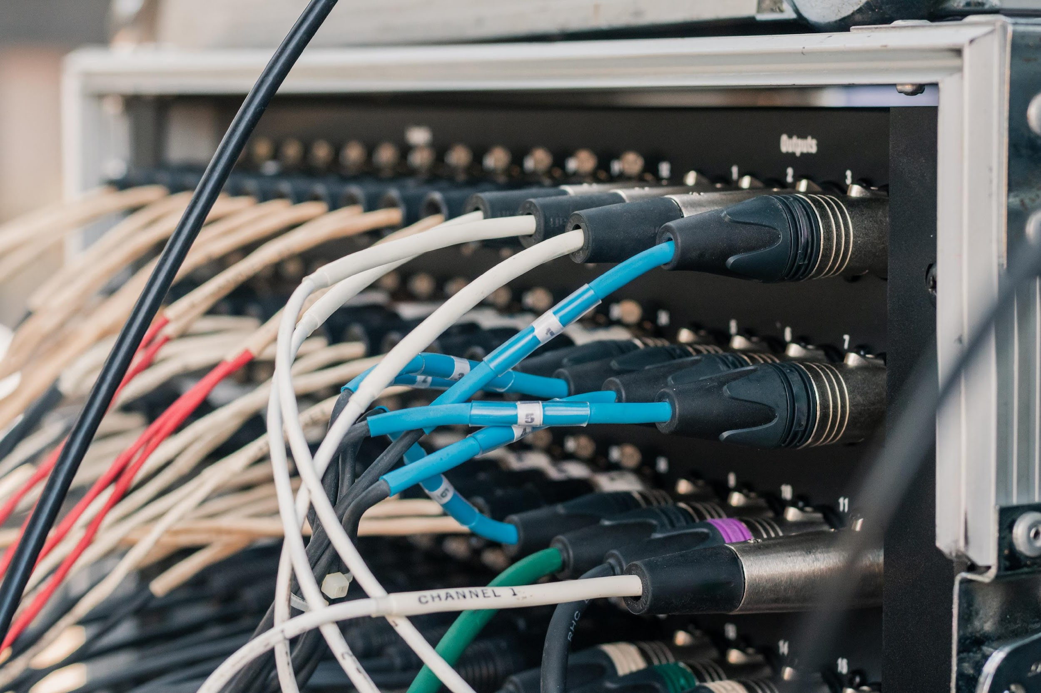
‹#›
Topic 3: Testing
© 2021 Milestones International College

Slide 42
‹#›
ACTIVITY: BRAINSTORM
List all areas of a network that you would need to test for performance and reliability.
Your trainer/assessor will facilitate a discussion.
Topic 3: Testing
© 2021 Milestones International College

Slide 43
‹#›
TESTING VLAN SOLUTIONS
In today’s current technological climate, virtualisation is a common approach to lowering costs, creating more optimised solutions, moving to more sustainable practices, increasing efficiency and productivity, managing cybercrime and is a platform for using cloud services.
Topic 3: Testing
Topic 1: Insert topic title
© 2021 Milestones International College

Slide 44
‹#›
ACTIVITY: DEVELOP
Firstly, read more about VLAN technologies.
Website: https://planetechusa.com/vlan-technology/
Draw a diagram to represent a VLAN segment, include different device connections.
Check with your trainer/assessor, what VLAN technologies are used at the college you are studying?
Topic 3: Testing
© 2021 Milestones International College

Slide 45
‹#›
ACTIVITY: READ
The provided article provides an explanation of switch-to-switch connectivity.
The provided article discusses configuring, verifying and troubleshooting a VLAN for Cisco.
The provided is an example of loop prevention for VLAN based solution.
Topic 3: Testing
© 2021 Milestones International College

Slide 46
‹#›
TESTING PRIVATE VLANS
Otherwise known as port isolation, private VLANs segments a VLAN domain into two or more subdomains. Each is defined by a primary and secondary VLAN.
Topic 3: Testing
Topic 1: Insert topic title
© 2021 Milestones International College

Slide 47
‹#›
ACTIVITY: READ
Read more on private VLANS from Cisco.
Website: https://www.cisco.com/en/US/docs/general/Test/dwerblo/broken_guide/pvlans.html#wp1134140
The following article provides a good overview of configuring private VLANS.
Website: https://packetlife.net/blog/2010/aug/30/basic-private-vlan-configuration/
Topic 3: Testing
© 2021 Milestones International College

Slide 48
‹#›
TEST SWITCH VIRTUAL INTERFACES (SVI)
A switch virtual interface (SVI) is the logical interface that is configured on a layer 3 switch; where SVI has no physical interface, providing layer 3 processing of packets from all switch ports associated with the VLAN.
Topic 3: Testing
Topic 1: Insert topic title
© 2021 Milestones International College

Slide 49
‹#›
ACTIVITY: WATCH
Watch the following video on switch virtual interfaces.
Video: https://www.youtube.com/watch?v=eWtwsX9AS6w (01:38)
Take down any key takeaways.
Topic 3: Testing
© 2021 Milestones International College

Slide 50
‹#›
TEST SWITCH SUPPORT OF ADVANCED SERVICES
It is important that you test switch support of advanced services such as for video, VoIP or wireless connection.
Topic 3: Testing
Topic 1: Insert topic title
© 2021 Milestones International College

Slide 51
‹#›
ACTIVITY: READ
This article explains traceroute for response delays and loops presented across switched nodes.
Website: https://www.thousandeyes.com/learning/glossary/traceroute
Here is a simple guide to troubleshooting common VoIP connection issues.
Website: https://getvoip.com/blog/2016/10/19/troubleshooting-voip-connections/
Topic 3: Testing
© 2021 Milestones International College

Slide 52
‹#›
TROUBLESHOOT SWITCH CONFIGURATION
It is important that you keep hold of all documented configurations when you first set up switches. If things go wrong, then you have a point of reference and at least an idea of what was done previously.
Topic 3: Testing
Topic 1: Insert topic title
© 2021 Milestones International College

Slide 53
‹#›
ACTIVITY: READ
Follow the Cisco troubleshooting LAN switching environments to gain further understanding of troubleshooting switch configurations.
Website: https://www.cisco.com/c/en/us/support/docs/lan-switching/ethernet/12006-chapter22.html#topic1
Write any notes on key information or to summarise what you have read. Keep the link for future reference.
Topic 3: Testing
© 2021 Milestones International College

Slide 54
‹#›
ACTIVITY: DEVELOP
Create a test plan.
Write a procedure that you could use to troubleshoot switch configuration for one device.
Seek feedback and support from your trainer/assessor.
Topic 3: Testing
© 2021 Milestones International College

